Slide 1
Security by Design
Ana Oprea
European Lead, Vulnerability Coordination Center
BSidesMunich
15 October 2023

Slide 2

Security & Reliability
Common properties
Invisibility
Assessment
Evolution
Different design considerations
Recovery time can be amplified by measures designed to increase the security of the system.

Slide 3
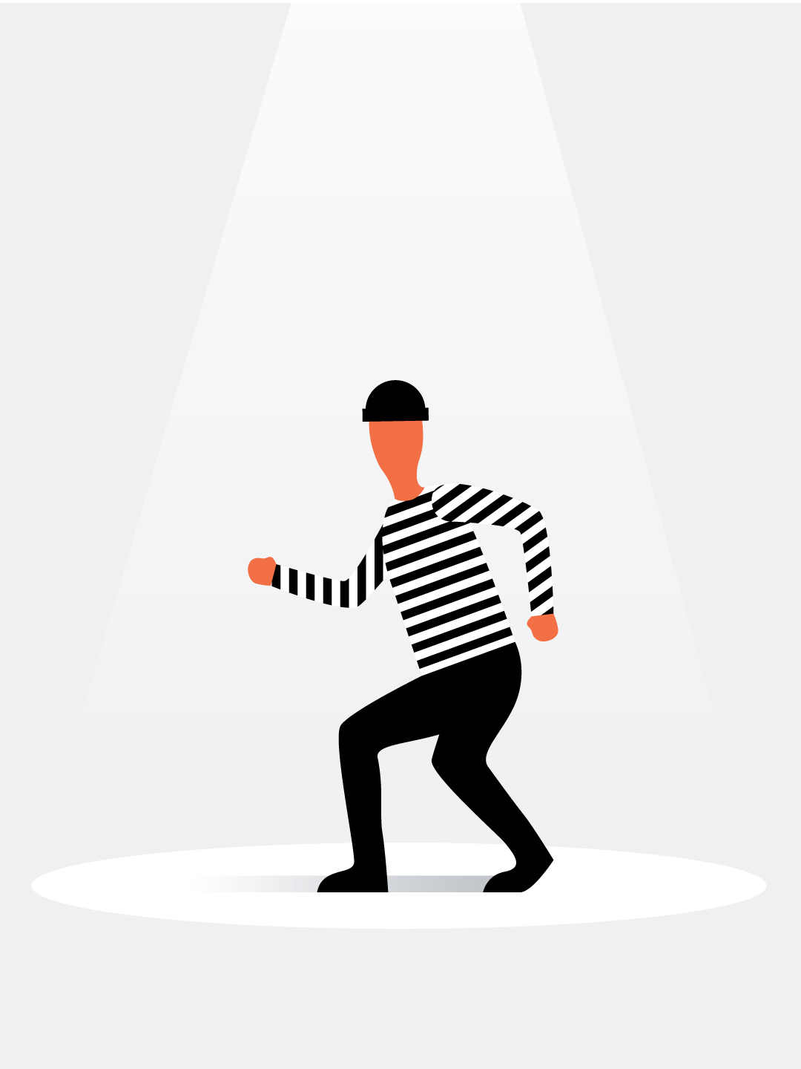
Vigilance != Greed
Managing Security Risk
Risk Assessment Considerations
You may not realize you’re a target.
Start with the basics.
Don’t underestimate your adversary.
Attribution is hard.
Attackers aren’t always afraid of being caught.

Slide 4
Humility != Pride
Managing Security Risk
Design Strategies - Least Privilege
Zero Trust
Multi-Party Authorization
Auditing and Detection
Recovery

Slide 5
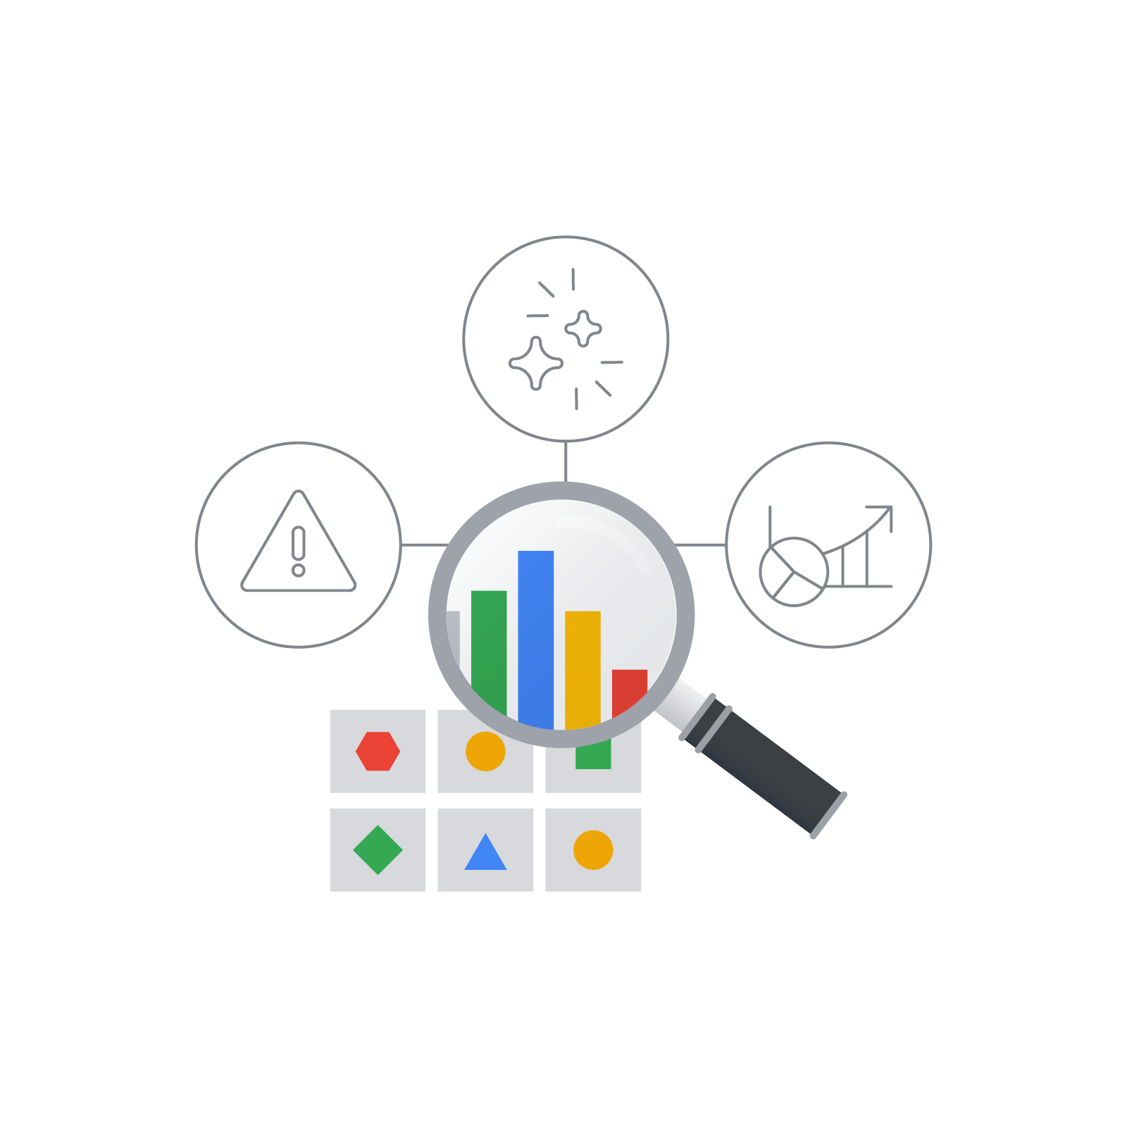
Mindfulness != Envy
Managing Reliability Risk
Error budgets
All stakeholders in the organization have approved a Service Level Objective (SLO) reliability target as being fit for the product
“Budget of unreliability” (or the error budget) represents the difference between 100% and the reliability target

Slide 6
Moderation != Gluttony
Managing Reliability Risk
Design Strategies - Least Privilege
Zero Touch
Multi-Party Authorization
Auditing and Detection
Recovery

Slide 7

Savvy != Lust
Design for Least Privilege
Auditing and Detection
What? Reviewing all access logs and justifications to make sure they’re appropriate.
When? Detecting incorrect authorization usage.
Pitfalls? Auditor missing context or objective.

Slide 8

Forethought != Wrath
Shift Security & Reliability Left
Numerous tradeoffs between security, reliability, and feature requirements
Commitment to the full system lifecycle
Security & Reliability central elements in the architecture of systems

Slide 9
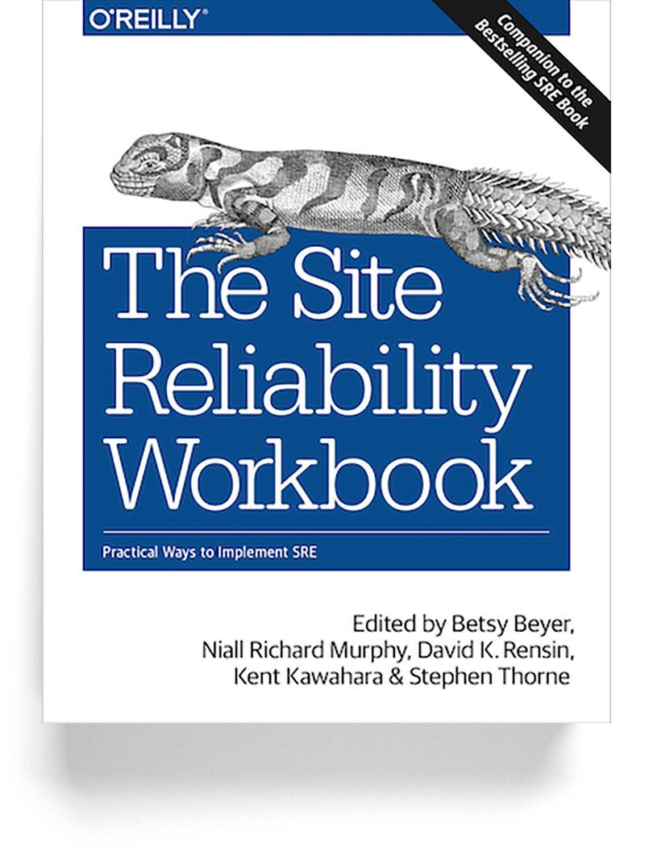
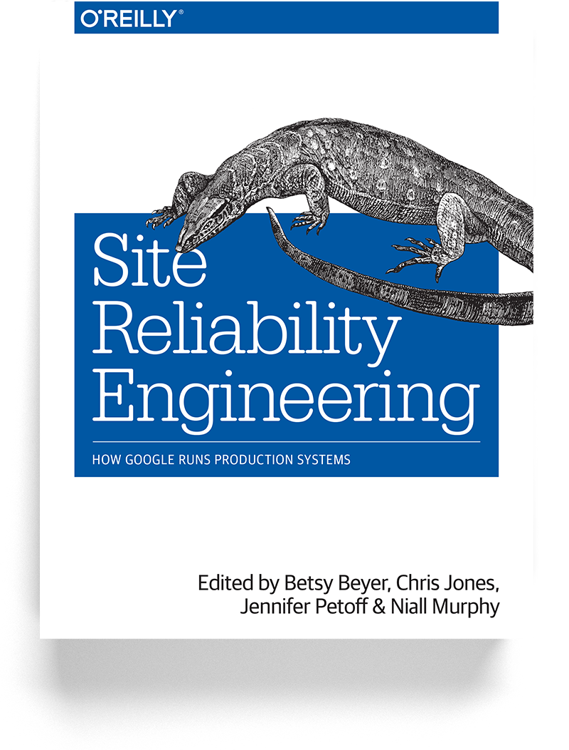
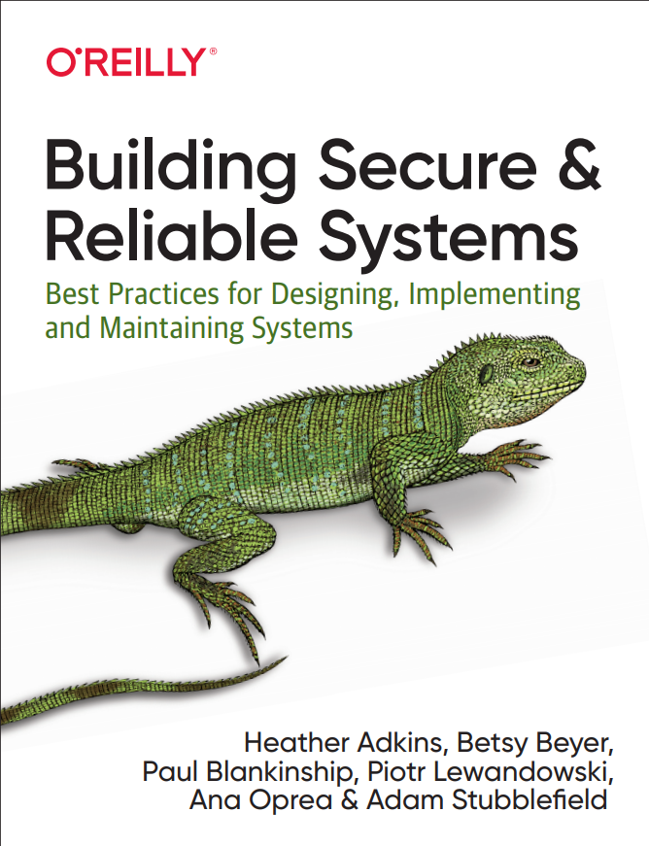
Diligence != Sloth
Thank you!
anaoprea@google.com
@0xa6ea
google.github.io/building-secure-and-reliable-systems
sre.google/books

